Slide 1
“Agenzia delle Entrate” REAL ESTATE INFORMATION SYSTEM
Updating of the Buildings Cadastre
through the IT application «DOCFA*»
Docfa
*«Documento Catasto Fabbricati»
Buildings Cadastre Document
Rome, November 20, 2014
Agenzia delle Entrate – Largo Leopardi, 5 00185 – Roma

Slide 2
TABLE OF CONTENTS
PRESENTATION SCOPE
ITALIAN BUILDINGS CADASTRE: FACTS & FIGURES
THE IT APPLICATION “DOCFA”:
A participatory procedure
How to submit documents
What data does it manage?
The cadastral income
SHORT TERM SCENARIOS
MID TERM SCENARIOS

Slide 3
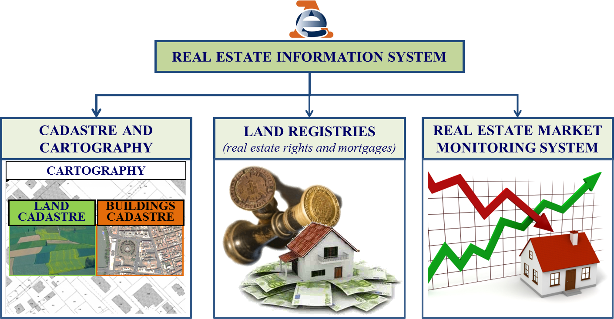
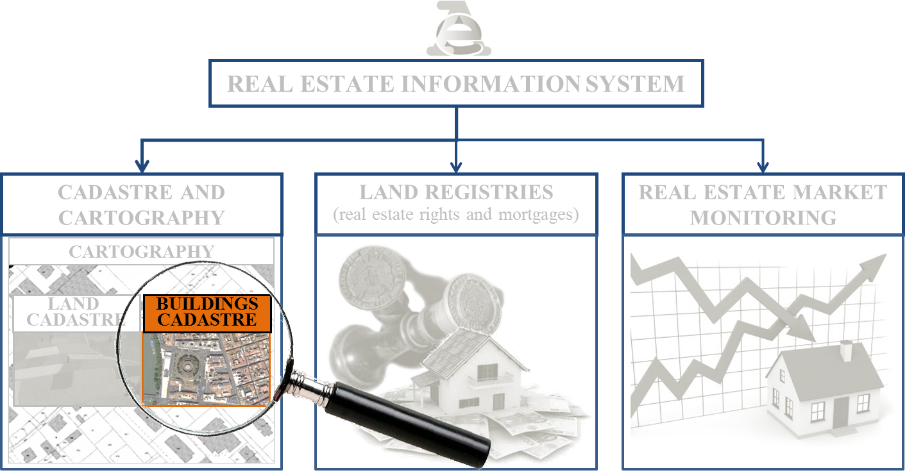
PRESENTATION SCOPE
To describe the ordinary process of updating the “Buildings Cadastre”, in the context of the “Agenzia delle Entrate” Real Estate Information System

Slide 4
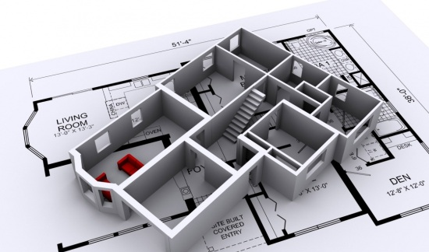
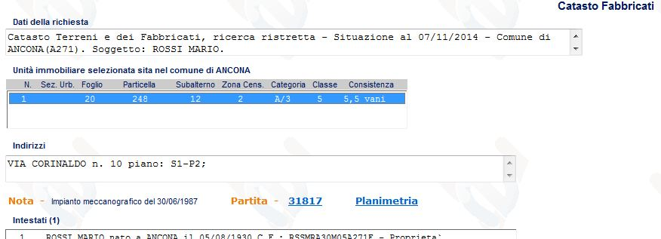
ITALIAN BUILDING CADASTRE: FACTS & FIGURES
Main functions of the Italian Cadastral System
Support to Civil and Administrative functions: to register and update real estate properties, legally identifying them
Fiscal function: to assign an economic value to the real estate properties
The Buildings Cadastre administrates data of 62 million real estate urban units (with assigned income value) by means of two digital archives
DESCRIPTIVE ARCHIVE
PLANS ARCHIVE
GRAPHICAL AND GEOMETRICAL INFORMATION
Detailed representation of the urban units (floorplans with room distribution, destination and measurements)
General representation of the building units (general plan)
descriptive
technical
economic
INFORMATION
The cadastral system guarantees the historical traceability of any data changes related to the urban units, since their cadastral registration

Slide 5
THE IT APPLICATION “DOCFA”: A PARTICIPATORY PROCEDURE
According to Italian cadastral rules, owners are obliged to declare the construction of new urban units and any changes subsequently brought to them.
Due to the technical complexity of the information to be declared, the updated document can be transmitted to the “Agenzia delle Entrate” only by private chartered surveyors, on behalf of the owners
Owners
Private Chartered Surveyors
Delegate

Slide 6
THE IT APPLICATION “DOCFA”: A PARTICIPATORY PROCEDURE
It is a participatory procedure
Surveyors submit an updating proposal to the “Agenzia delle Entrate”, which performs its controls.
The updating information is then sent to the Municipalities that may point out incongruities with the information in their possession
Municipalities
Incongruities can be pointed out
Informed
Control
Owners
Surveyors
Agenzia delle Entrate
Cadastral income
proposal control
(plus random on-site inspection ≃ 10%)
Control
Delegate→
Formal and Substantial Controls
Updating
of the information
justified refusal
Cadastral income modification must be notified to owners
Cadastral income modification

Slide 7
HOW TO SUBMIT “DOCFA” DOCUMENTS
The chartered technical surveyors download the IT application “Docfa” from the “Agenzia delle Entrate” web site, free of charge. They fill out “Docfa” documents in digital format and submit them through two different channels
Delivery of the documents to the
FRONT OFFICE
both on digital support and on paper, duly signed
24%*
1
Private
Chartered
Surveyors
Control
*2 million “Docfa” submitted (2013)
digitally signed
http://sister.agenziaentrate.it/
ONLINE SUBMISSION
through the Web Portal “Sister”
2
76%*

Slide 8
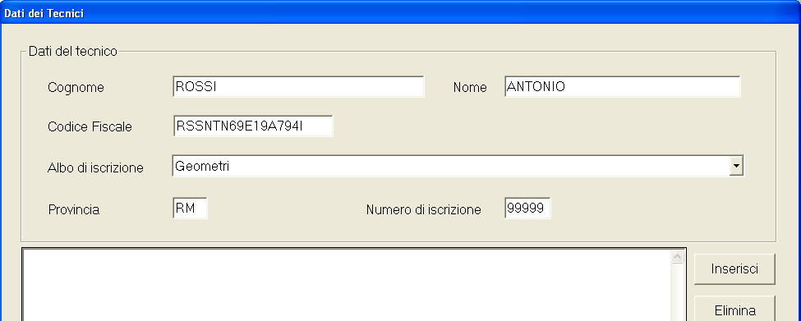
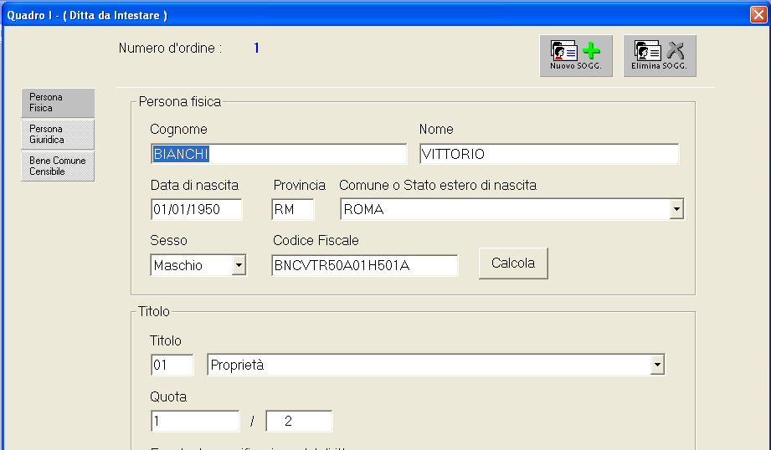
WHAT DATA DOES “DOCFA” MANAGE?
The following information can be entered by filling out the appropriate digital forms:
ADMINISTRATIVE DATA
1) Delegate Surveyor’s personal data (drafter’s data)
2) Owners’ personal data, with related real estate rights and shares

Slide 9
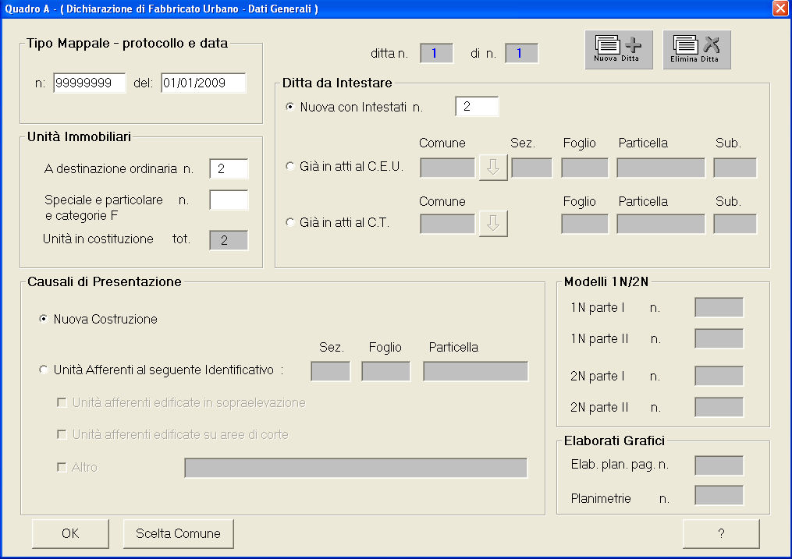
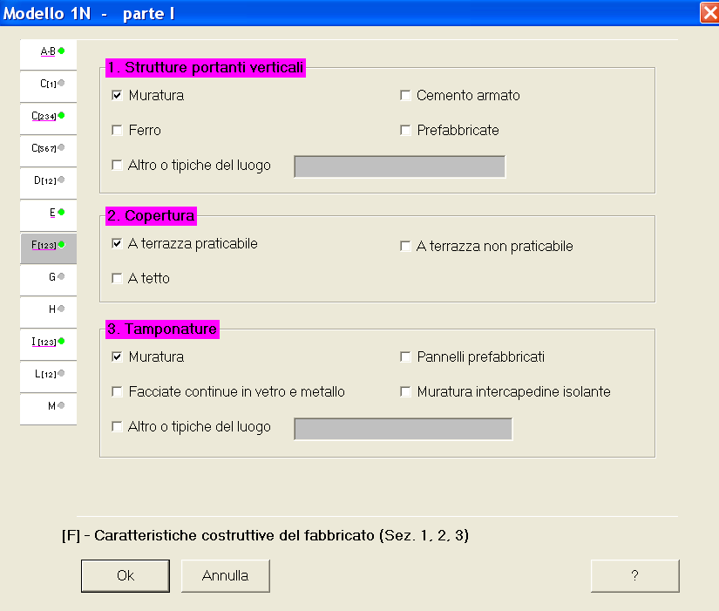
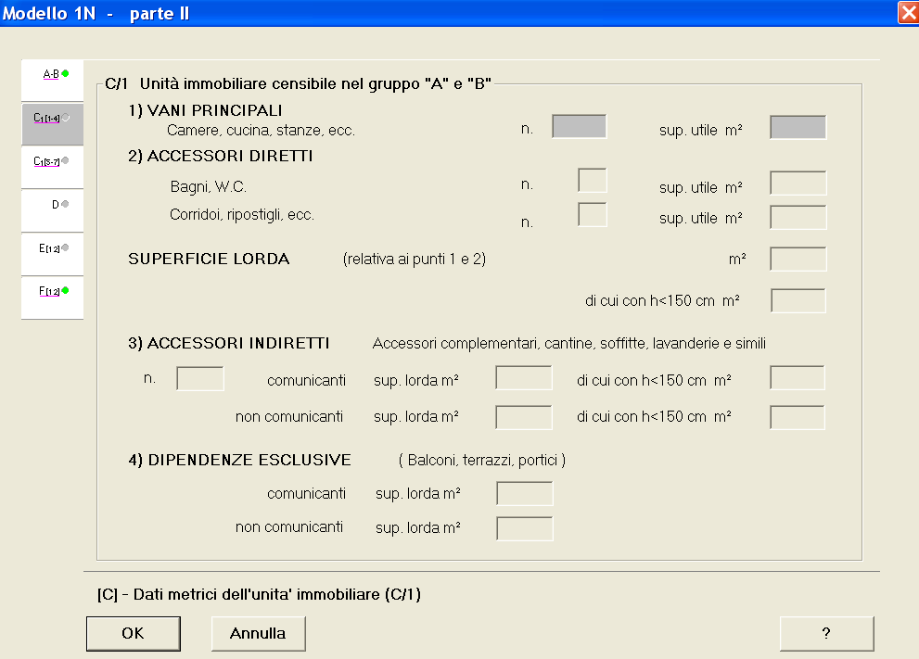
WHAT DATA DOES “DOCFA” MANAGE?
TECHNICAL DATA
3) Cadastral description of the urban units to be updated
number of units, address, cadastral code, typology (ordinary or special use)
4) Technical data of the building in which urban units are contained
5) Technical data of each urban unit which must be updated
floor level, size (cadastral rooms, m², m³) category (specific use of the unit)

Slide 10
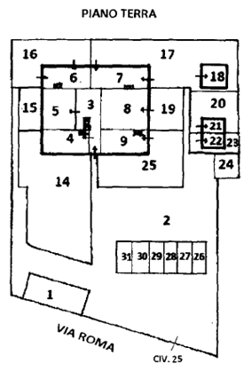
WHAT DATA DOES “DOCFA” MANAGE?
GRAPHICAL AND GEOMETRICAL DATA
Specific “Docfa” tools allow to acquire drawings (plans) and to measure unit areas
General plan (elaborato planimetrico)
A general drawing of all units present on each floor of the building (plus list of all units in the building)
Urban unit floorplan (planimetria)
A detailed drawing of each urban unit, showing room distribution and related use
Urban unit area measurement
Through “room polygon” drawing

Slide 11
THE CADASTRAL INCOME
The cadastral income is the economic component of the information associated to each urban unit and represents its theoretic yearly income (ref. to1988-89 period)
Urban units for “ORDINARY” use
(houses, offices, shops, etc.)
The cadastral income is calculated by associating to the urban unit the proper category and productivity class (to which a specific “per-unit tariff” is assigned”)
Cadastral Income = urban unit size (cadastralrooms/m²/m³) X per-unit tariff (€)
Urban units for “SPECIAL or PARTICULAR” use
(e.g. industrial buildings, malls, airports, railway stations, etc.)
The cadastral income is calculated by specific assessment, unit by unit
Participatory procedure: The delegate professional proposes a cadastral income by submitting a “Docfa” document, which is controlled by the “Agenzia delle Entrate”.
(Control is mandatory for “Special urban units”)

Slide 12
THE CADASTRAL INCOME: FACTS & FIGURES
Number of urban units (with cadastral income)
62,2 millions
60.6 millions
1.6 million
“ORDINARY USE”
URBAN UNITS
(97,5%)
(2,5%)
“SPECIAL USE” URBAN UNITS
25 billions
11 billions
(69%)
(31%)
Total value of cadastral income
36 € billions
Notes:
12

Slide 13
THE CADASTRAL INCOME: FACTS & FIGURES
The cadastral income is used to calculate the taxable base for several real estate taxes (State and Municipal) such as, e.g.:
Municipal Property Tax (IMU)
Municipal Service Tax (TASI)
“Real estate rights” transfer taxes
Registry Tax (the cadastral income is used only for certain “real estate rights” transfers)
Cadastral Tax
Notes:
13

Slide 14
SHORT TERM SCENARIOS
100%
Mandatory Online Submission
(by June 2015)
Achievable thanks to the cooperation of the Chartered Professional Organizations
Digital Preservation
“WORM” SERVER (Write Once Read Many)
“PDF/A” DOCUMENTS (Portable Document Format/Archiving)
No more paper!

Slide 15
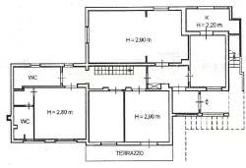
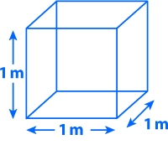
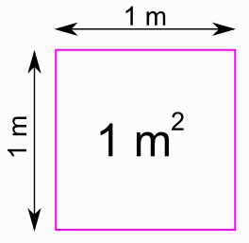
MID TERM SCENARIOS
5 years
INCOME VALUE CADASTRE
INCOME VALUE CADASTRE
CAPITAL VALUE CADASTRE
In March 2014, Italian Parliament delegated the Government to start up an historical Reform of the Building Cadastre Assessment System, which would attribute to each real estate urban unit both:
an Income Value (Income Value Cadastre)
a Capital Value (Capital Value Cadastre)
These values would be related to market values of a three-year-period (for «ordinary use» urban units calculated on a statistical basis and using square meters as sole unit of measurement)
AS IS
TO BE
Cadastral Rooms
(e.g. houses)
Cubic Meter
(e.g. schools)
Square Meter
(e.g. shops)
Square meter
(all ordinary units)

Slide 16
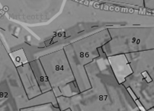
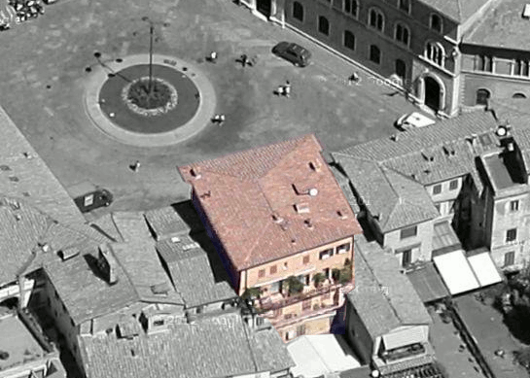
MID TERM SCENARIOS
The “new Docfa” will therefore have to manage both income and capital values, calculated through:
Statistic assessment functions (for “Ordinary use” urban units)
Specific assessment, unit by unit (for “Special use” urban units)
Furthermore, it will allow to declare the characteristics of new buildings or their subsequent changes, which will be registered in a new «Buildings Archive».
Through the the «Building Object», it will be easier to locate the urban units on an integrated land management system («SIT») and to manage some building characteristics affecting their assessment
«SIT»
«G.I.S.» System
Urban Units
Capital Value
Income Value
Buildings Archive
Vector Map

Slide 17
Thank you for your kind attention
Lucio Tropia
Central Directorate for Cadastre and Cartography
Services Development Office Manager
lucio.tropia@agenziaentrate.it
Dc_cc@agenziaentrate.it

